Slide 1
OPEN PROJECT#1 : HW+SW Baby Motion Sensor with BTLE
Thomas Tsai
thomas@biotrump.com
https://www.facebook.com/groups/taiwan.open.platform.club/

Slide 2
DISCLAIMER
All Trademarks mentioned herein belong to their respective owners.
The OWNER is located at http://www.biotrump.com and http://www.open-platform-club.org/.
All the information contained in the pages is provided “as is”.
The OWNER disclaims all warranties with regard to this information, including all implied warranties of merchantability and fitness for a particular purpose.
In no event shall The OWNER be liable for any special, indirect or consequential damages or any damages whatsoever resulting from loss of use, data or profits, whether in an action of contract, negligence or other tortious action, arising out of or in connection with the use or performance of this information.
The information contained in the pages could contain technical inaccuracies or typographical errors.
The OWNER reserve the right to make changes to any information contained within the pages and to make improvements and or changes in the products and programs described in the pages at any time and without notice.

Slide 3
Part I BTLE introduction
Bluetooth Low Energy, Bluetooth Core V4.0

Slide 4
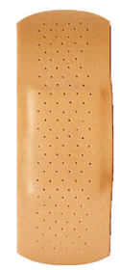
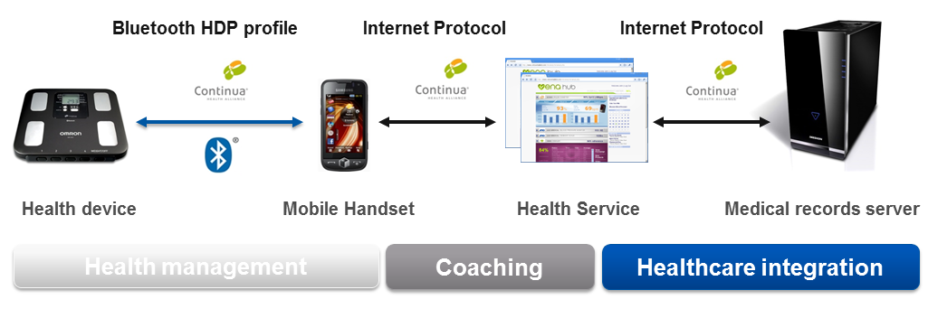
Product Hierarchy

Slide 5
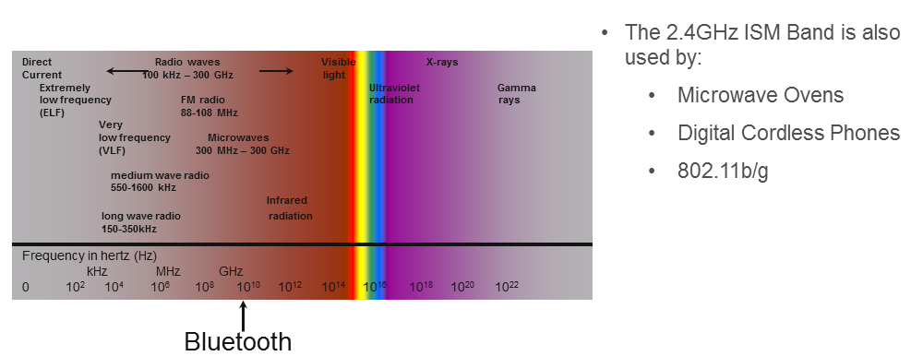
Bluetooth Low Energy

Slide 6
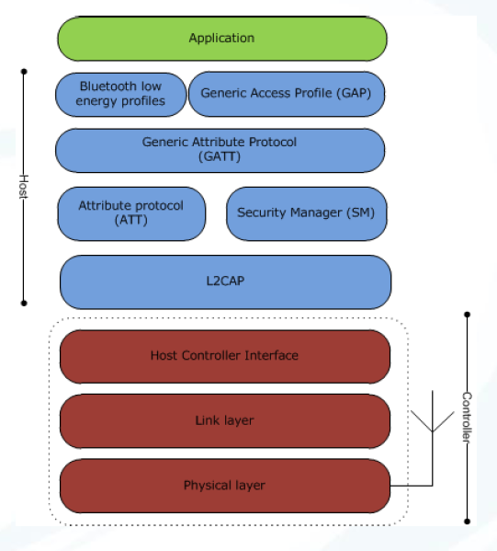
Architecture
L2CAP
Segmentation and reassembly of packets
ATT
Ability to read/write attribute values
GATT
Grouping of attributes

Slide 7
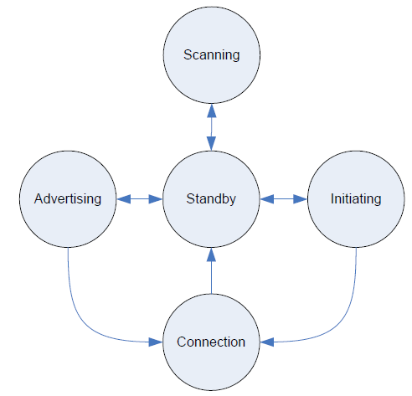
Link Layer State Machine
The Link Layer state machine allows only one state to be active at a time.
The Link Layer shall have at least one Link Layer state machine that supports one of Advertising State or Scanning State.
The Link Layer may have multiple instances of the Link Layer state machine.
Certain combinations of states and roles within multiple state machines in the Link Layer are prohibited.

Slide 8
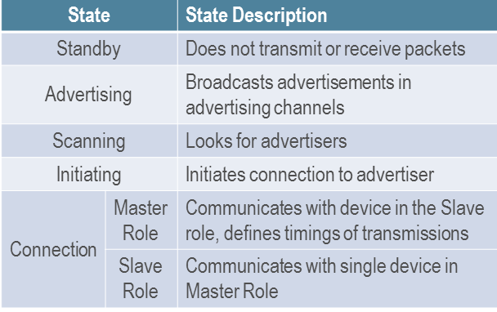
Operating States and Roles

Slide 9
Link Layer States
Standby State does not transmit or receive any packets.
Can be entered from any other state.
Advertising State will be transmitting advertising channel packets and possibly listening to and responding to responses triggered by these advertising channel packets.
A device in the Advertising State is known as an advertiser.
Can be entered from the Standby State.
Scanning State will be listening for advertising channel packets from devices that are advertising.
A device in the Scanning State is known as a scanner.
can be entered from the Standby State.
Initiating State will be listening for advertising channel packets from a specific device(s) and responding to these packets to initiate a connection with another device.
Initiating State is known as an initiator.
can be entered from the Standby State.
The Connection State can be entered either from the Initiating State or the Advertising State.
A device in the Connection State is known as being in a connection.

Slide 10
Two roles in the connection State
The Link Layer in the Connection State shall not operate in the Master Role and Slave Role at the same time.
Master Role
When entered from the Initiating State, the Connection State shall be in the Master Role.
The Link Layer in the Master Role will communicate with a device in the Slave Role and defines the timings of transmissions.
May have multiple connections.
Slave Role
When entered from the Advertising State, the Connection State shall be in the Slave Role.
The Link Layer in the Slave Role will communicate with a single device in the Master Role.
shall have only one connection.
The Link Layer may optionally support multiple state machines.

Slide 11
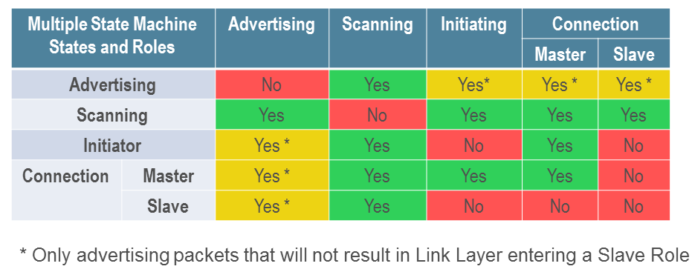
Link Layer state machine state combinations
A link layer state machine can have only one state.
Ie, If a device is in slave connection state, the device can start another state machine with state only advertising and scanning. The other states are not allowed in the new state machine.

Slide 12
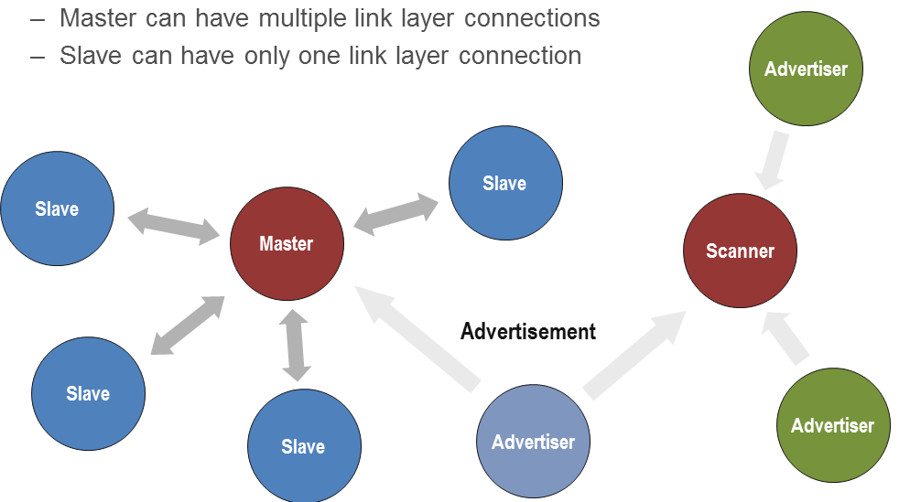
Star Topology

Slide 13
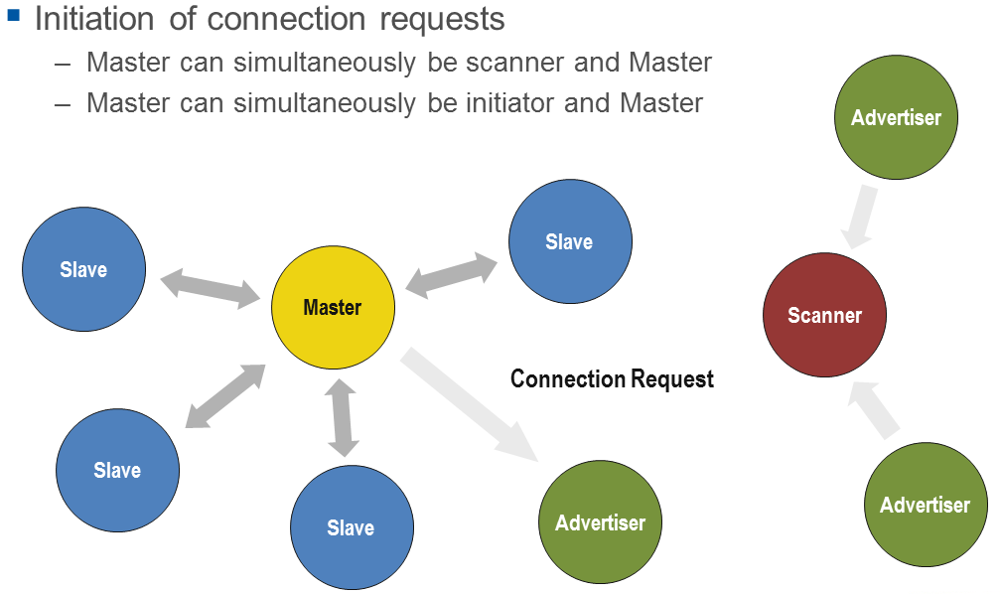

Slide 14
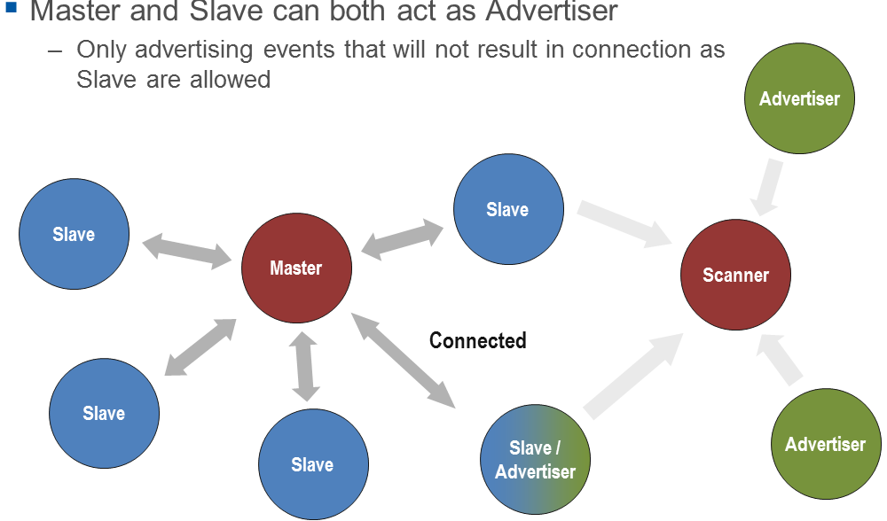
A device can have multiple link layer state machines. Each state machine can have only one possible state.
When a device is connected as a slave, it can still advertise, but the slave device can’t setup another connections to the other masters.
When a device becomes a master, it can setup another connections to the other slave.

Slide 15
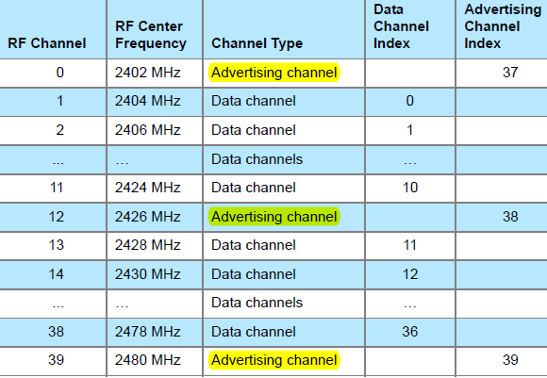
Advertising and Data Channel Indexes

Slide 16
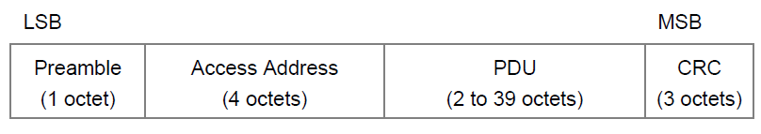
AIR INTERFACE PACKETS
The Link Layer has only one packet format used for both advertising channel packets and data channel packets.
Each packet consists of four fields:
the preamble, the Access Address, the PDU, and the CRC.
The shortest packet is 80 bits in length.
The longest packet is 376 bits in length.
preamble 1 byte
The Advertising channel packets shall have 10101010b
The data channel packet preamble is either 10101010b or 01010101b, depending on the LSB of the Access Address

Slide 17
Access Address
The Access Address for all advertising channel packets shall be 10001110100010011011111011010110b (0x8E89BED6).
This is NOT device address.
The Access Address in data channel packets shall be different for each Link Layer connection between any two devices with certain restrictions as defined below.
The Access Address shall be a random 32-bit value, generated by the device in the Initiating State and sent in a connection request as defined in Section 2.3.3.1.
The initiator shall ensure that the Access Address meets the following requirements:
It shall have no more than six consecutive zeros or ones.
It shall have a minimum of two transitions in the most significant six bits.
Detailed are not all included.

Slide 18
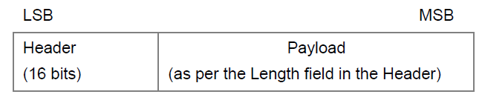
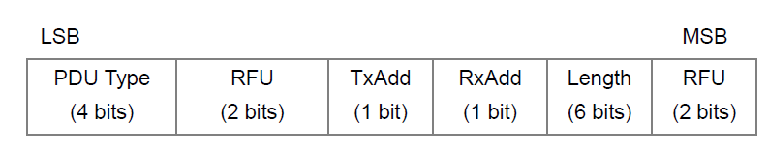
ADVERTISING CHANNEL PDU
The advertising channel PDU has a 16-bit header and a variable size payload.
Its format is as shown in
The 16 bit Header field of the advertising channel PDU is as shown in

Slide 19
Device address
One advertising channel PDU payload only contains the advertiser's device address and the initiator's device address in which the advertisement is directed.
Devices are identified using a device address.
either a public device address or a random device address.
A device shall contain at least one type of device address and may contain both.
A public device address and a random device address are both 48 bits in length.
company_assigned field is contained in the 24 least significant bits
company_id field is contained in the 24 most significant bits
The public device address shall be created in accordance with section 9.2 ("48-bit universal LAN MAC addresses") of the IEEE 802-2001 standard.
The random device address is divided into the following two fields:
hash field is contained in the 24 least significant bits
random field is contained in the 24 most significant bits

Slide 20
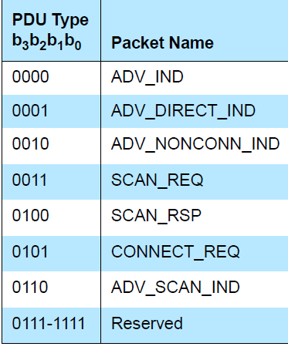
Advertising channel PDU type
ADV_IND: connectable undirected advertising event
ADV_DIRECT_IND: connectable directed advertising event
ADV_NONCONN_IND: non-connectable undirected advertising event
ADV_SCAN_IND: scannable undirected advertising event
These PDUs are sent by the Link Layer in the Advertising State and received by a Link Layer in the Scanning State or Initiating State

Slide 21
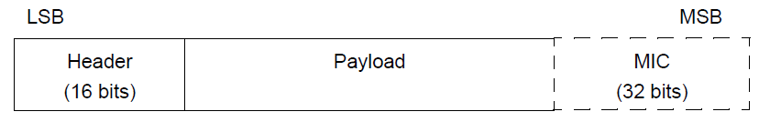
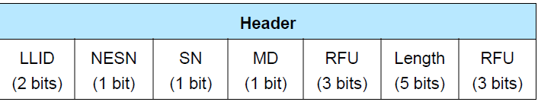
Data Channel PDU
16 bit header, a variable size payload, and may include a Message Integrity Check (MIC) field.

Slide 22
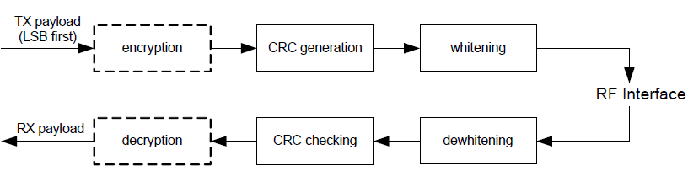
BIT STREAM PROCESSING
Bluetooth devices shall use the bitstream processing schemes as defined in the following
Payload bit processes

Slide 23
LINK LAYER DEVICE FILTERING
The Link Layer may perform device filtering based on the device address of the peer device.
Link Layer Device Filtering is used by the Link Layer to minimize the number of devices to which it responds.
The filter policies for the Advertising State, Scanning State and Initiating State are independent of each other.
If the Link Layer does not support the Advertising State, Scanning State, or Initiating State, the corresponding filter policy is not required to be supported.

Slide 24
White List
The set of devices that the Link Layer uses for device filtering is called the White List.
A White List contains a set of White List Records used for Link Layer Device Filtering.
A White List Record contains both the device address and the device address type (public or random).
All Link Layers supporting Link Layer Device Filtering shall support a White List capable of storing at least one White List Record.
On reset, the White List shall be empty.
The White List is configured by the Host and is used by the Link Layer to filter advertisers, scanners or initiators.
This allows the Host to configure the Link Layer to act on a request without awakening the Host.
All the device filter policies shall use the same White List.

Slide 25
Standby State
The Standby State is the default state in the Link Layer.
The Link Layer shall not send or receive packets in the Standby State.
The Link Layer may leave the Standby State to enter the Advertising State, Scanning State or Initiator State.

Slide 26
Advertising State
The Link Layer shall enter the Advertising State when directed by the Host.
When placed in the Advertising State, the Link Layer shall send advertising PDUs in advertising events.
Each advertising event is composed of one or more advertising PDUs sent on used advertising channel indexes.
The advertising event shall be closed after one advertising PDU has been sent on each of the used advertising channel Indexes
or the advertiser may close an advertising event earlier to accommodate other functionality.

Slide 27
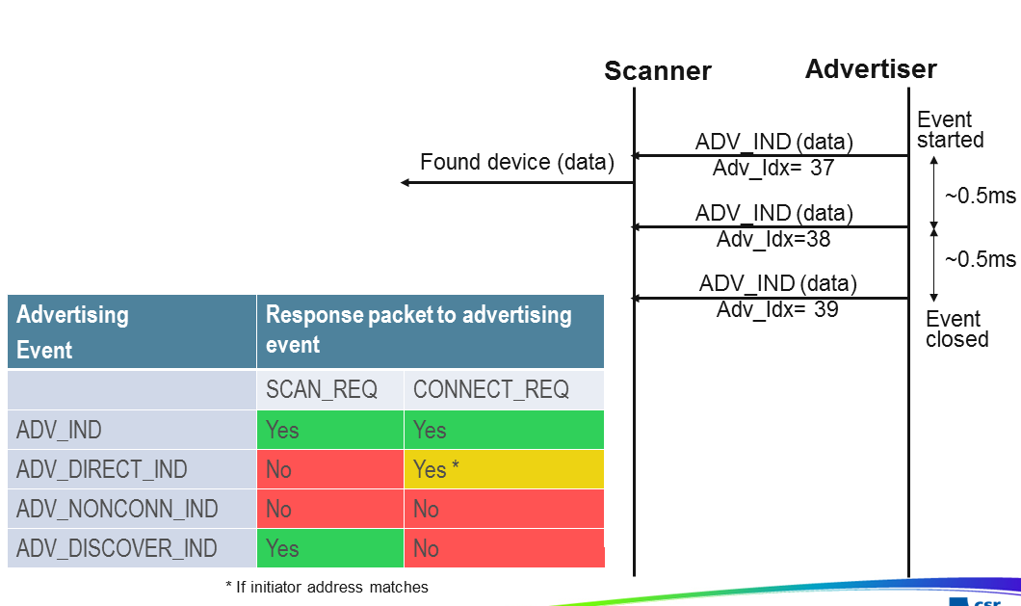
Advertising

Slide 28
OVERVIEW OF BLUETOOTH LOW ENERGY OPERATION
Devices that transmit advertising packets on the advertising PHY channels are referred to as advertisers.
Devices that receive advertising on the advertising channels without the intention to connect to the advertising device are referred to as scanners.
Devices that need to form a connection to another device listen for connectable advertising packets. Such devices are referred to as initiators.
If the advertiser is using a connectable advertising event, an initiator may make a connection
request using the same advertising PHY channel on which it received the connectable
advertising packet.
The advertising event is ended and connection events begin if the advertiser receives and accepts the request for a connection be initiated.
Once a connection is established, the initiator becomes the master device in what is referred to as a piconet and the advertising device becomes the slave device.
Connection events are used to send data packets between the master and slave devices.
In connection events, channel hopping occurs at the start of each connection event.
Within a connection event, the master and slave alternate sending data packets using the same data PHY channel.
The master initiates the beginning of each connection event and can end each connection event at any time.

Slide 29
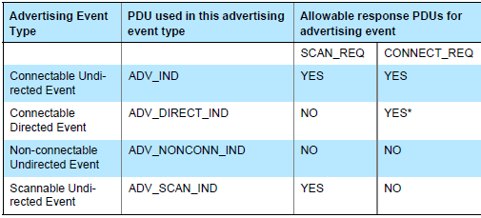
advertising event type
a connectable undirected event
a connectable directed event
a non-connectable undirected event
a scannable undirected event

Slide 30
Scanning State
The Link Layer shall enter the Scanning State when directed by the Host.
When scanning, the Link Layer shall listen on the advertising channel indices.
There are two types of scanning, determined by the Host: passive and active.
There are no strict timing or advertising channel index selection rules for scanning.

Slide 31
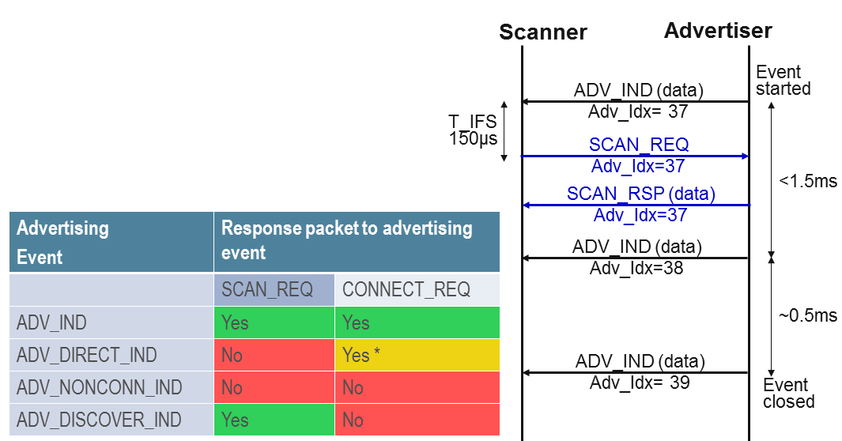
Active Scanning

Slide 32
Initiating State
The Link Layer shall enter the Initiating State when directed by the Host.
When initiating, the Link Layer shall listen on the advertising channel indices.
There are no strict timing or advertising channel index selection rules for initiators.
During initiating, the Link Layer listens on an advertising channel index for the
duration of the scan window, scanWindow.
The scan interval, scanInterval, is defined as the interval between the start of two consecutive scan windows.
The Link Layer should listen for the complete scanWindow every scanInterval as directed by the Host unless there is a scheduling conflict.
In each scan window, the Link Layer should listen on a different advertising channel index.
The Link Layer shall use all the advertising channel indexes.
After sending the CONNECT_REQ PDU, the Link Layer shall exit the Initiating State, and shall transition to the Connection State in the Master Role

Slide 33
CONNECTION STATE
The Link Layer enters the Connection State when an initiator sends a CONNECT_REQ PDU to an advertiser.
An advertiser receives a CONNECT_REQ PDU from an initiator.
After entering the Connection State, the connection is considered to be created.
The connection is not considered to be established at this point.
The connection is only considered to be established once a data channel packet has been received from the peer device.
The only difference between a created connection and a established connection is the Link Layer connection supervision timeout value that is used.
When two devices are in a connection, the two devices act in different roles.
A Link Layer in the Master Role is called a master. A Link Layer in the Slave Role is called a slave.
The master controls the timing of a connection event.
A connection event is a point of synchronization between the master and the slave.

Slide 34
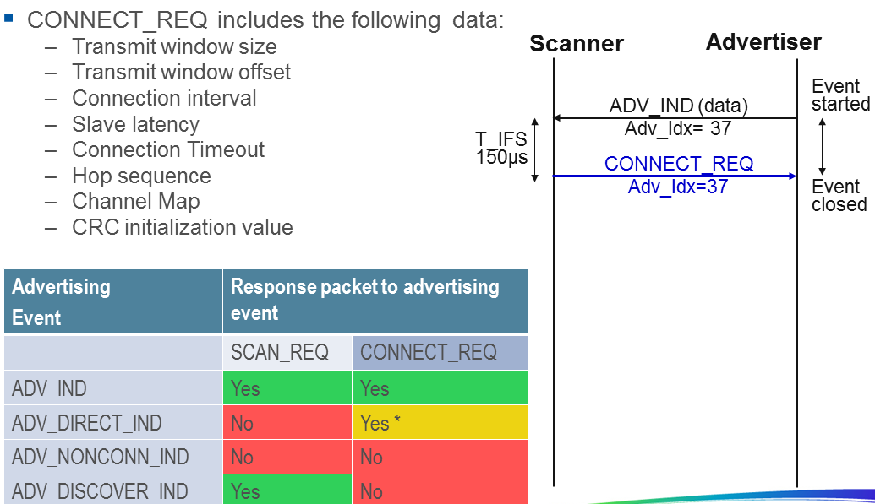

Slide 35
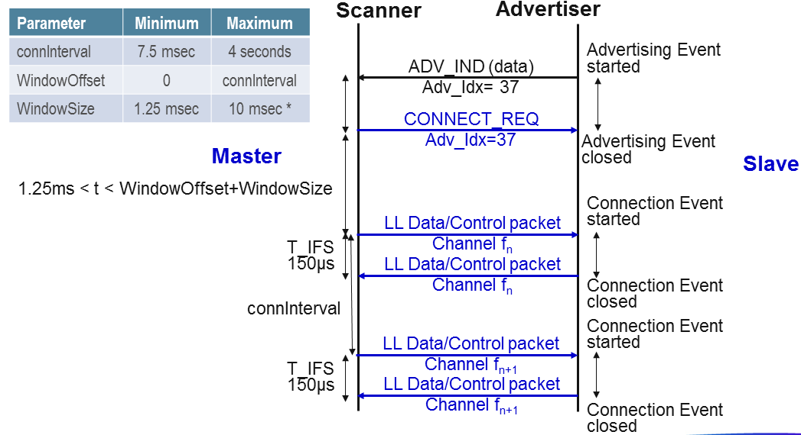

Slide 36
Connection Setup – Master Role
After the initiator sends the CONNECT_REQ PDU the Link Layer is in Connection State in the Master Role.
The master shall reset the Link Layer connection supervision timer TLLconnSupervision.
The Link Layer shall notify the Host that the connection has been created.
The first connection event shall use the data channel index as specified in Section 1.4.1.
The master shall start to send the first packet within the transmit window as defined in Section 4.5.3. It is permitted that the master’s first packet can extend beyond the transmit window.
The first packet sent in the Connection State by the master determines the anchor point for the first connection event, and therefore the timings of all future connection events in this connection.
The second connection event anchor point shall be connInterval after the first connection event anchor point.
All the normal connection event transmission rules specified in Section 4.5.1 shall apply.
Two examples of the LL connection setup procedure timing from master’s perspective are shown in Figure 4.11 and in Figure 4.12.

Slide 37
Connection Setup – Slave Role
After the advertiser receives a CONNECT_REQ PDU the Link Layer is in Connection State in the Slave Role.
The slave shall reset the Link Layer connection supervision timer TLLconnSupervision. The Link Layer shall notify the Host that the connection has been created.
The first connection event shall use the data channel index as specified in Section 1.4.1.
The slave shall start to listen for the first packet within the transmit window as defined in Section 4.5.3. It is permitted that the master’s first packet can extend beyond the transmit window, and therefore the slave must take this into account.
The first packet received, regardless of a valid CRC match (i.e., only the access code matches), in the Connection State by the slave determines the anchor point for the first connection event, and therefore the timings of all future connection events in this connection.
If a packet is not received in a transmit window, the slave shall attempt to receive a packet in a subsequent transmit window.
A subsequent transmit window shall start connInterval after the start of the previous transmit window, with the same transmitWindowSize.
The data channel index shall be the next data channel index as specified in Section 1.4.1. The connEventCount shall also be incremented by one.

Slide 38
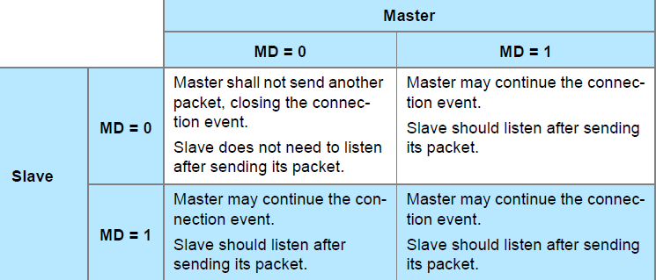
Closing Connection Events
The MD bit of the Header of the Data Channel PDU is used to indicate that the device has more data to send.
If neither device has set the MD bit in their packets, the packet from the slave closes the connection event.
If either or both of the devices have set the MD bit, the master may continue the connection event by sending another packet, and the slave should listen after sending its packet.
If a packet is not received from the slave by the master, the master will close the connection event.
If a packet is not received from the master by the slave, the slave will close the connection event.
Two consecutive packets received with an invalid CRC match within a connection event shall close the event.

Slide 39
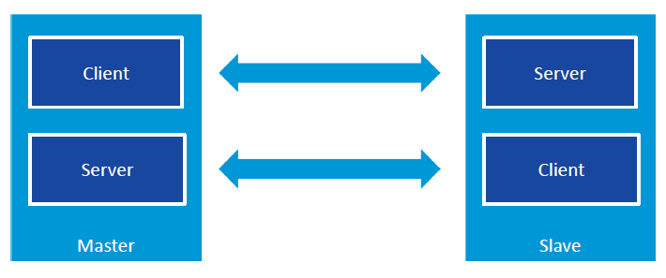
ATT Layer Overview
Link Layer Connection Role : Master , Slave
Attribute Arch : Client , Server

Slide 40
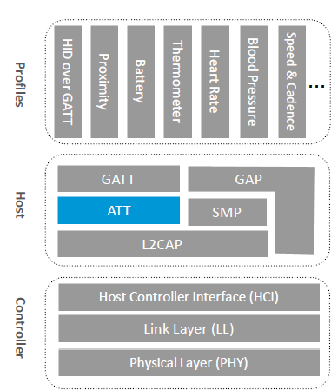
Attribute Protocol Overview
Mandatory and used for all data transfers in BLE
Fast, simple
Client – Server architecture
Server stores data
Client requests data
clients writes data to server
Server initiates Notifications and Indications
Supports for fine-grained security

Slide 41
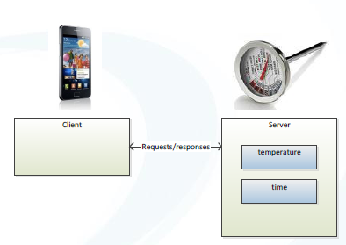
Attribute Protocol (ATT)
The only protocol used in Bluetooth low energy
Uses client server architecture
servers store data
clients request data from server
clients writes data to server
Protocol Methods
Client to server: Read, write
Server to client: Notify, indicate

Slide 42
ATT 4 Fields
Handle
Index in the ATT Table, used in ATT transaction PDU
The Attributes are ordered by increasing Attribute Handle values.
Attribute Handle values may begin at any value between 0x0001 and 0xFFFF.
Although the Attribute Handle values are in increasing order, following Attribute Handle values may differ by more than one. That is to say there may be gaps between successive Attribute Handles.
UUID – Universal Unique Identifier
128-bit UUID
16-bit short UUID using Bluetooth Base 0000XXXX-0000-1000-8000-00805F9B34FB
Permissions – Read, Write.
It is used by the server to determine whether read or write access is permitted for a given attribute.
Attribute Permissions are established by the GATT profile, a higher layer profile or are implementation specific if not specified.
Value – data can be read/written by Client

Slide 43
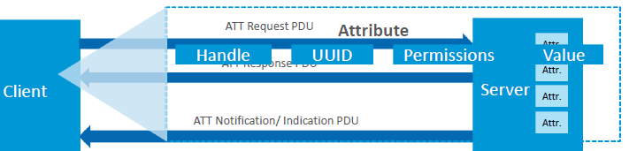
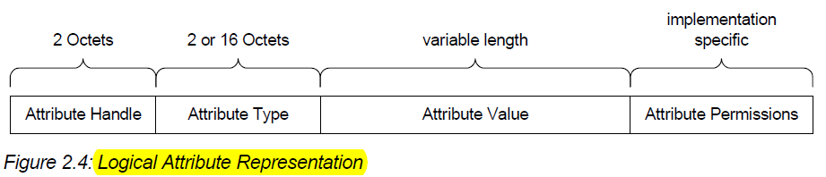
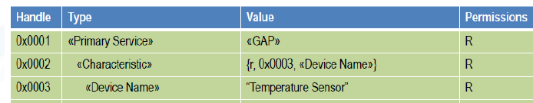

Slide 44
Attribute Operation
Attribute operations: read
Client requests data when it needs it
Client polls server for attribute value
This may be inefficient if data doesn’t change often
Shouldn’t be used for frequently changing data that you are monitoring
Attribute operations: write
Client can set attributes to configure a server
E.g. set the room temperature to 22ºC

Slide 45
Attribute operations: notify
Server sends the data when it changes
Attribute operations: indicate
Server sends the data when it changes
Client confirms that is has received the data

Slide 46
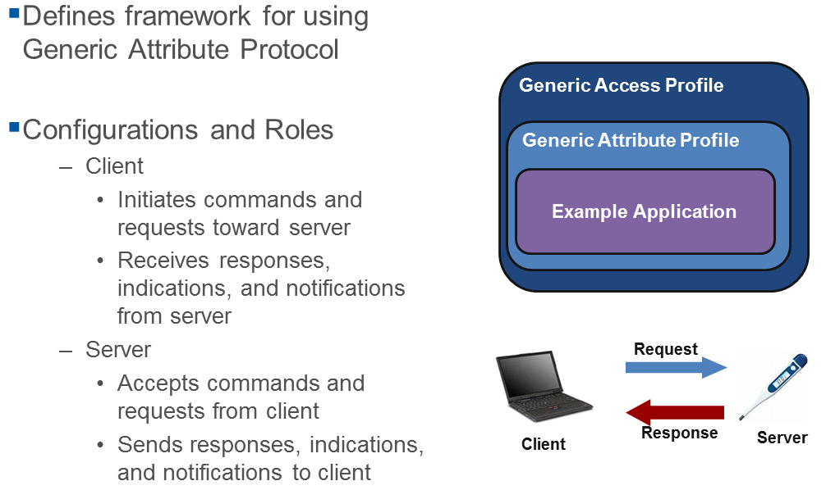
Generic Attribute Profile GATT

Slide 47
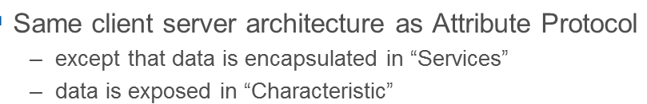
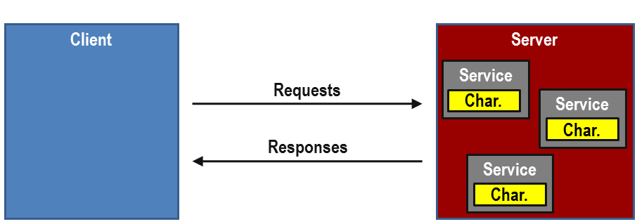
GATT Client Server Architecture

Slide 48
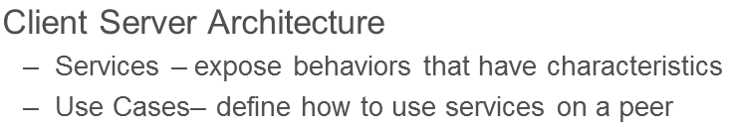
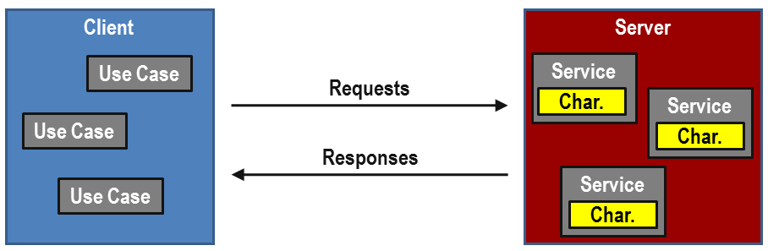
BTLE application

Slide 49
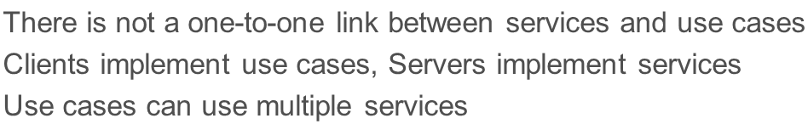
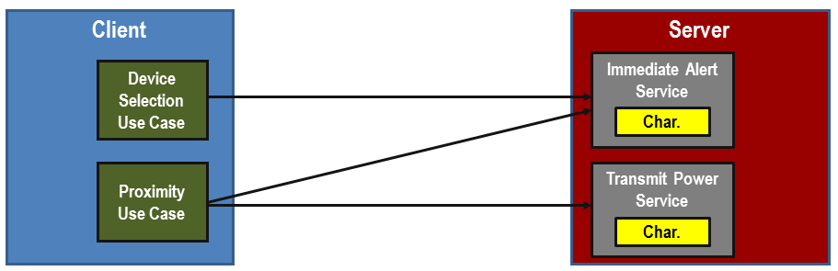
Use Cases and Services

Slide 50
GATT PROFILE HIERARCHY
The top level of the hierarchy is a profile.
A profile is composed of one or more services necessary to fulfill a use case.
A service is composed of characteristics or references to other services.
Each characteristic contains a value and may contain optional information about the value.
The service and characteristic and the components of the characteristic (i.e. value and descriptors) contain the profile data and are all stored in Attributes on the server.

Slide 51
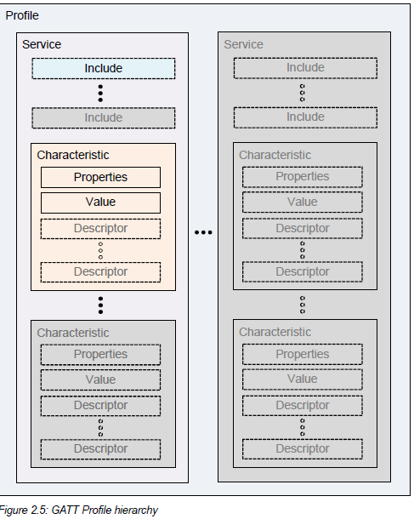

Slide 52
GATT Definition
service : is a collection of data and associated behaviors to accomplish a particular function or feature
Primary service : that exposes the primary usable functionality of this device. A primary service can be included by another service. Primary services can be discovered using Primary Service Discovery procedures.
Secondary service : a service that is only intended to be referenced from a primary service or another secondary service or other higher layer specification
Included service
An included service is a method to reference another service definition existing on the server into the service being defined
When a service definition uses an include definition to reference the included service, the entire included service definition becomes part of the new service definition
Characteristic
contains a characteristic declaration, characteristic properties, and a value
and may contain descriptors that describe the value or permit configuration of the server with respect to the characteristic.

Slide 53
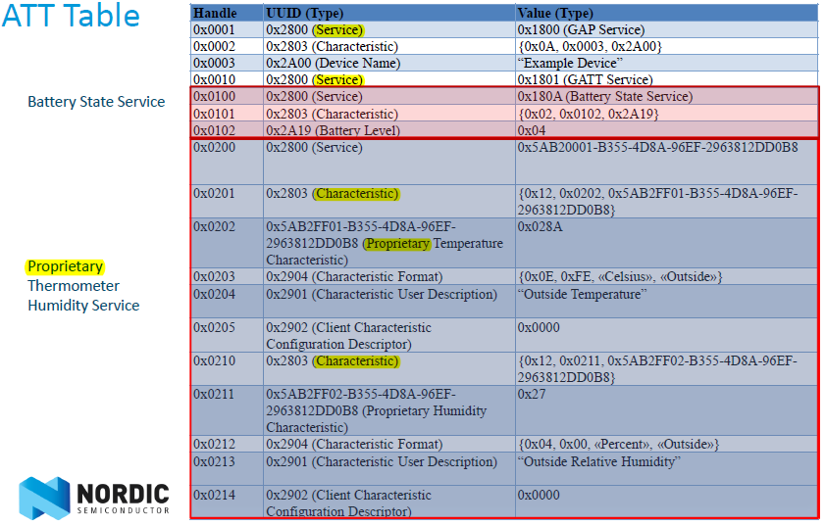

Slide 54
SERVICE DEFINITION
A service definition shall contain a service declaration and may contain include definitions and characteristic definitions.
The service definition ends before the next service declaration or after the maximum Attribute Handle is reached.
Service definitions appear on the server in an order based on Attribute Handle.
All include definitions and characteristic definitions contained within the service definition are considered to be part of the service.
All include definitions shall immediately follow the service declaration and precede any characteristic definitions.
A service definition may have zero or more include definitions.
All characteristic definitions shall be immediately following the last include definition or in the event of no include definitions, immediately following the service declaration.
A service definition may have zero or more characteristic definitions.
There is no upper limit for include or characteristic definitions.

Slide 55
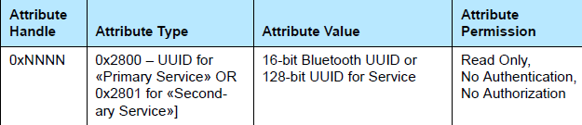
service declaration
A service declaration is an Attribute
with the Attribute Type set to the UUID for «Primary Service» or «Secondary Service».
The Attribute Value shall be the 16-bit Bluetooth UUID or 128-bit UUID for the service, known as the service UUID.
A client shall support the use of both 16-bit and 128-bit UUIDs.
A client may ignore any service definition with an unknown service UUID.
An unknown service UUID is a UUID for an unsupported service.
The Attribute Permissions shall be read-only and shall not require authentication or authorization.
When multiple services exist,
services definitions with service declarations using 16-bit Bluetooth UUID should be grouped together (i.e. listed sequentially) and
services definitions with service declarations using 128-bit UUID should be grouped together.
https://developer.bluetooth.org/gatt/services/Pages/ServicesHome.aspx

Slide 56
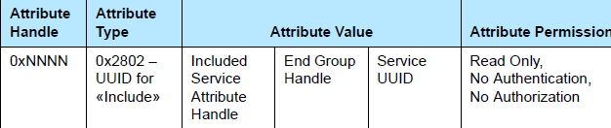
INCLUDE DEFINITION
An include definition shall contain only one include declaration.
The include declaration is an Attribute with the Attribute Type set to the UUID for «Include».
The Attribute Value shall be set to the included service Attribute
Handle, the End Group Handle, and the service UUID.
The Service UUID shall only be present when the UUID is a 16-bit Bluetooth UUID.
The Attribute Permissions shall be read only and not require authentication or authorization.
A server shall not contain a service definition with an include definition to another service that references the original service.
This applies to each of the services the included definition references.
This is referred to as a circular reference.
If the client detects a circular reference or detects nested include declarations to a greater level than it expects, it should terminate the ATT Bearer.

Slide 57
CHARACTERISTIC DEFINITION
A characteristic definition shall contain
a characteristic declaration,
a Characteristic Value declaration and
may contain characteristic descriptor declarations.
A characteristic definition ends at the start or the next characteristic declaration or service declaration or after the maximum Attribute Handle.
Characteristic definitions appear on the server within a service definition in an order based on Attribute Handle.
The two required declarations are the characteristic declaration and the Characteristic Value declaration.
The Characteristic Value declaration shall exist immediately following the characteristic declaration.
Any optional characteristic descriptor declarations are placed after the Characteristic Value declaration.
The order of the optional characteristic descriptor declarations is not significant.

Slide 58
A characteristic definition may be defined to concatenate several Characteristic Values into a single aggregated Characteristic Value.
This may be used to optimize read and writes of multiple Characteristic Values through the reading and writing of a single aggregated Characteristic Value.
The characteristic declaration shall use a characteristic UUID that is unique to characteristic definition.
The aggregated characteristic definition may also contain a characteristic aggregate format descriptor that describes the display format of the aggregated Characteristic Value.

Slide 59
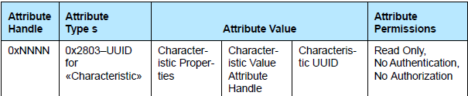
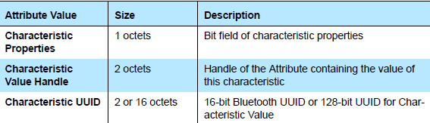
Characteristic Declaration
A characteristic declaration is an Attribute with the Attribute Type set to the UUID for «Characteristic» and
Attribute Value set to the Characteristic Properties, Characteristic Value Attribute Handle and Characteristic UUID.
The Attribute Permissions shall be readable and not require authentication or authorization.
The characteristic declaration Attribute Value shall not change while the server has a trusted relationship with any client.

Slide 60
Characteristic Properties in attribute value
The Characteristic Properties bit field determines how the Characteristic Value can be used, or how the characteristic descriptors (see Section 3.3.3) can be accessed.
If the bits defined in Table 3 5 are set, the action described is permitted.
Multiple Characteristic Properties can be set.
These bits shall be set according to the procedures this characteristic supports, without regard to security requirements

Slide 61
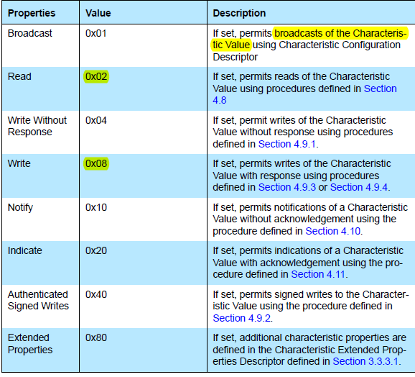

Slide 62
Characteristic Value Attribute Handle Characteristic UUID
Characteristic Value Attribute Handle is the Attribute Handle of the Attribute that contains the Characteristic Value.
The Characteristic UUID field is a 16-bit Bluetooth UUID or 128-bit UUID that describes the type of Characteristic Value.
A client shall support the use of both

Slide 63
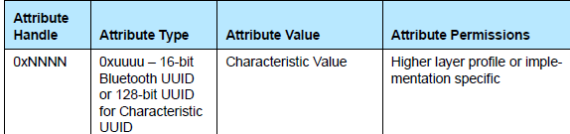
Characteristic Value Declaration
The Characteristic Value declaration contains the value of the characteristic.
It is the first Attribute after the characteristic declaration.
All characteristic definitions shall have a Characteristic Value declaration.
A Characteristic Value declaration is an Attribute with the Attribute Type set to the 16-bit Bluetooth or 128-bit UUID for the Characteristic Value used in the characteristic declaration.
The Attribute Value is set to the Characteristic Value.
The Attribute Permissions are specified by the service or may be implementation specific if not specified otherwise.

Slide 64
Characteristic Descriptor Declarations
Characteristic descriptors are used to contain related information about the Characteristic Value.
The GATT profile defines a standard set of characteristic descriptors that can be used by higher layer profiles.
Higher layer profiles may define additional characteristic descriptors that are profile specific.
Each characteristic descriptor is identified by the characteristic descriptor UUID.
The characteristic descriptor declaration may appear in any order within the characteristic definition.
The client shall not assume the order in which a characteristic descriptor declaration appears in a characteristic definition following the Characteristic Value declaration.
Characteristic descriptor declaration permissions are defined by a higher layer profile or are implementation specific.
A client shall not assume all characteristic descriptor declarations are readable.

Slide 65
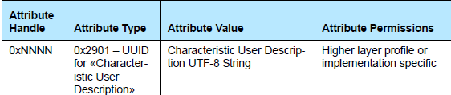
Characteristic User Description
The Characteristic User Description declaration is an optional characteristic descriptor that defines a UTF-8 string of variable size that is a user textual description of the Characteristic Value.
If the Writable Auxiliary bit of the Characteristic Properties is set then this characteristic descriptor can be written.
The characteristic descriptor may occur in any position within the characteristic definition after the Characteristic Value.
Only one Characteristic User Description declaration shall exist in a characteristic definition.
The characteristic descriptor is contained in an Attribute and
the Attribute Type shall be set to the UUID for «Characteristic User Description» and the Attribute Value shall be set to the characteristic user description UTF-8 string.
The Attribute Permissions are specified by the profile or may be implementation specific if not specified otherwise.

Slide 66
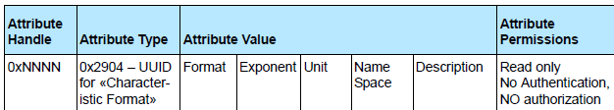
Characteristic Presentation Format
The characteristic descriptor is contained in an Attribute.
The Characteristic Presentation Format declaration is an optional characteristic descriptor that defines the format of the Characteristic Value.
The characteristic descriptor may occur in any position within the characteristic definition after the Characteristic Value.
If more than one Characteristic Presentation Format declarations exist, in a characteristic definition, then a Characteristic Aggregate Format declaration shall exist as part of the characteristic definition.
The characteristic format value is composed of five parts: format, exponent, unit, name space, and description.
The Attribute Type shall be set to the UUID for «Characteristic Format».
The Attribute Value shall be set to the characteristic descriptor value.
The Attribute Permissions shall be read only and not require authentication or authorization.

Slide 67
Generic Access Profile GAP
Define Profile Roles
Broadcaster (advertiser)
Observer (scanner)
Central (master)
Peripheral (slave)
Define Procedures
Discovering identities, names, and basic capabilities
Creating bonds
Exchange of Security Information
Establish connections
Resolvable Private addresses
Define Advertising and Scan Response Data formats
All profiles are built upon GAP

Slide 68
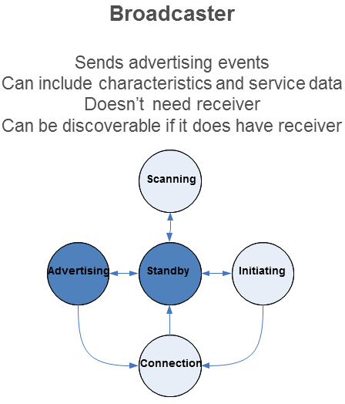
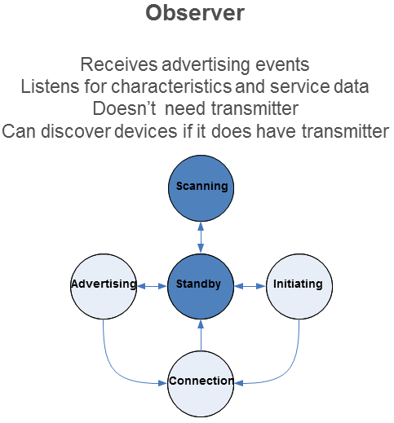
Profile Roles

Slide 69
